Slide 1
Hornet15

Slide 2
Hornet15 includes 15 minute activities each Monday and a Fun Friday trivia each week. These activities are aimed at increasing positivity and attendance in school.

Slide 4
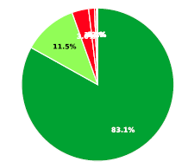
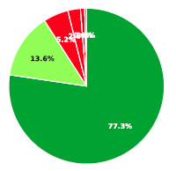
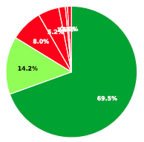
Early Warning Systems
Overall Warning
2019-2020 Semester 1 2020-2021 Semester 1 2021-2022 Semester 1
Overall level of risk for disengagement and dropping out of high school, based on attendance, behavior, and course performance

Slide 5
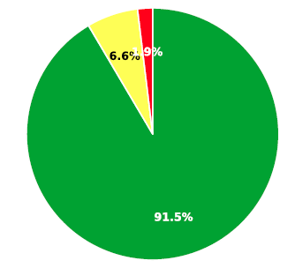
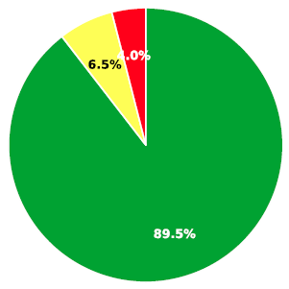
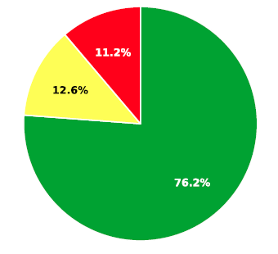
Attendance Percent of students “flagged” for attendance issues using the following criteria: Missed 20% of instructional time (middle school) & Missed 10% of instructional time (high school)
2019-20 Semester 1 2020-21 Semester 1 2021-22 Semester 1

Slide 6
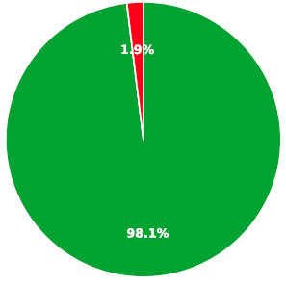
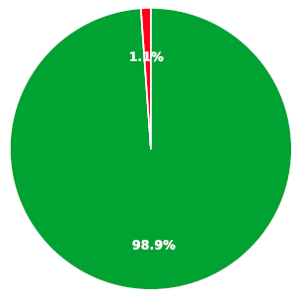
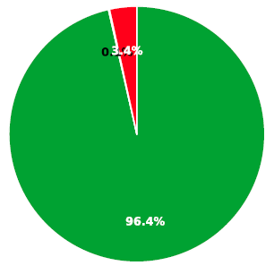
Behavior Percent of students “flagged” as at-risk using the following criteria: 1 or more suspensions & 1 or more office referrals
2019-20 Semester 1 2020-21 Semester 1 2021-22 Semester 1

Slide 7
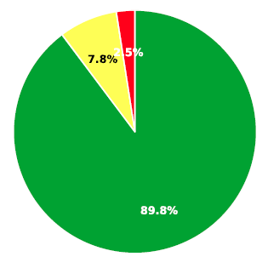
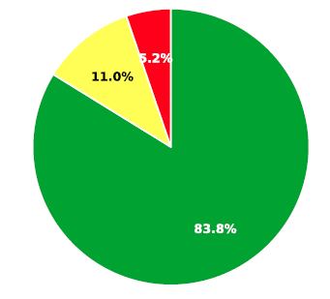
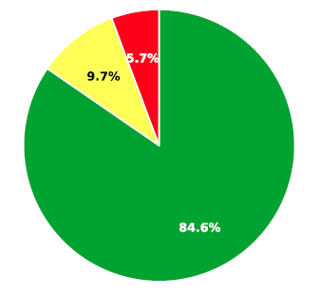
Course Performance Percent of students “flagged” at-risk using the following criteria: Failing ELA or Math (middle school) & Failing 1 or more courses (high school)
2019-20 Semester 1 2020-21 Semester 1 2021-22 Semester 1

Slide 8
Hornet15: Competencies
Self-Awareness
-Demonstrating honesty and integrity
-Linking feelings, values, and thoughts
-Developing interests and a sense of purpose
Social Awareness
-Recognizing strengths in others
-Demonstrating empathy and compassion
-Showing concern for the feelings of others
-Understanding and expressing gratitude
Self-Management
-Identifying and using stress management strategies
-Exhibiting self-discipline and self-motivation
-Setting goals
-Using planning and organizational skills
-Showing the courage to take initiative

Slide 9
Hornet15: Competencies
Relationship Building
-Communicating
-Positive relationships
-Teamwork/Collaboration
-Resolving conflicts
-Resisting negative social pressure
-Showing leadership
Responsible Decision Making -Curiosity and open-mindedness
-Learning to make reasoned judgment
-Identifying solutions to problems

Slide 10
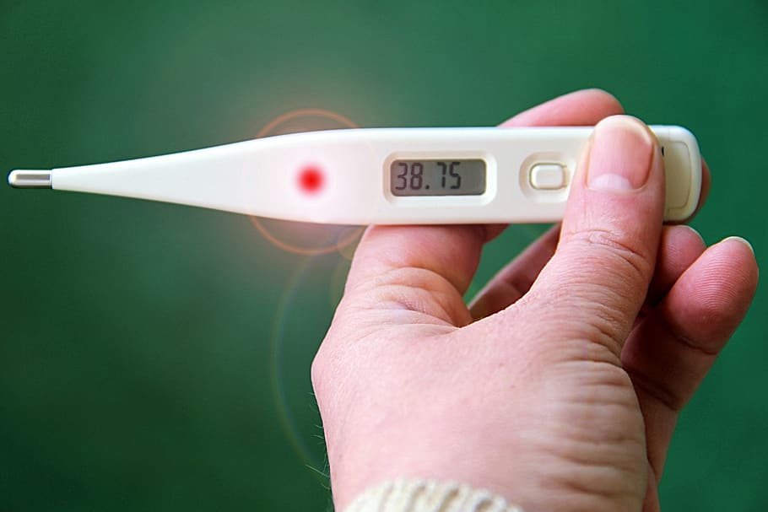
Universal screeners promote prevention
“Temperature check”
Analyze where to put resources
Evaluate interventions and strategies
Does NOT diagnose
Notes:
Who is at risk? What % of your population is at risk?
When included with other pieces of data (e.g. attendance, course performance) we can determine what we need to remediate and what we need to boost.

Slide 11
SAEBRS

Slide 12
Social, Academic, and Emotional Behavior Risk Screener (SAEBRS)
Completed three times per year
October, January, April. At this time, only the students will be completing the screener.
Link to the screener: Student mySAEBRS questions
Students will tentatively be completing the mySAEBRS on 10/31/2022. If you would like to opt your student out of completing the above screener, please send an email to Ms. Kuchar by Thursday (10/27) at 3:00 p.m. This is sufficient documentation for opting out.

Slide 13
Contact Information
High School Main Office: 810-638-5054
Kim Kuchar: kkuchar@newlothrop.k12.mi.us High School Principal | ext. 2228
Joanna Czymbor: jczymbor@newlothrop.k12.mi.us School Counselor | ext. 2231
Amanda Kviz: akviz@newlothrop.k12.mi.us School Social Worker | ext. 2258
Sara Lewandowski: lewandowksi@sresd.org School Psychologist | ext. 2266

